Slide 1
UNIVERSITY EVENT MANAGEMENT SYSTEM
Presented by:
Dinesh deivamani - 001898851
Raghavan Renganathan - 001886377
vinitha Ravichandran - 001846275

Slide 2
ABSTRACT:
Events are one of the great ways to meet new people, hear their stories, get to know each other. Also, events are where one could expand their knowledge, by getting to know great minds, share their experience and get inspired.
Therefore, the top universities often conduct various events with various speakers to share their contribution in their domain of expertise with the students. That’s how new ideas are born, and legacies are formed.

Slide 3
Problem Statement:
The main problem that most of the universities face is that there is no generic application where a university can manage all their events with ease and where students can be informed about the events and gain knowledge and excel.
Currently, some universities are still using the traditional ‘contact everyone via email’ methodology for scheduling events. Meanwhile, a whole lot of universities have shifted to cloud services, like Google Calendar, Microsoft Outlook, etc. However, the management will be easier if they could have their own application, which is specialized for addressing this problem. This also enables the university to collect data and perform analysis which would help the university to understand their students’ interest and schedule events based on that.

Slide 4
APPROACH:
The Application Master, a.k.a. Admin, creates all the colleges and departments, along with the users (Faculties and students) and special actors (Event managers, etc.).
When a new event is going to be organized, it can be created by event manager, faculty, or students. Based on who creates the event, it will be decided whether an approval is required. All students cannot create an event, only certain students (Class representative, club president, etc.) can create events.
Once an event is created, the event owner will be given admin access for that event and he/she can invite others including guests and other students. Once an invite is sent the invitees can either accept or reject the invite. Students can then login to their accounts and see the events they have registered for.

Slide 5
APPROACH (contd.):
During the event, all the invitees who have confirmed their presence will be checked-in and those who confirmed and didn’t show up will be marked. When a person gets marked three consecutive times, he/she will be blacklisted from registering for further events.
In addition to this, open events with limited seats can also be created where anyone can register for the event.
Other than the event organizers and attendees, there will be sponsors who can fund the events. Special reservations will be made for the sponsors for that event.
This will be the basic functionality of our application and it can be scaled up to include more functionalities and to include more roles.

Slide 6
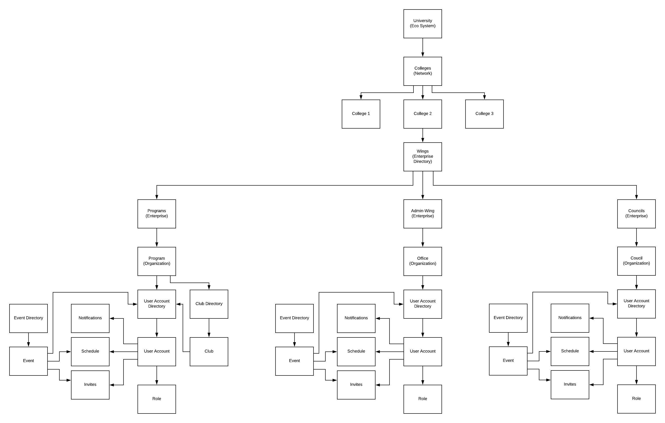
OBJECT MODEL:

Slide 7
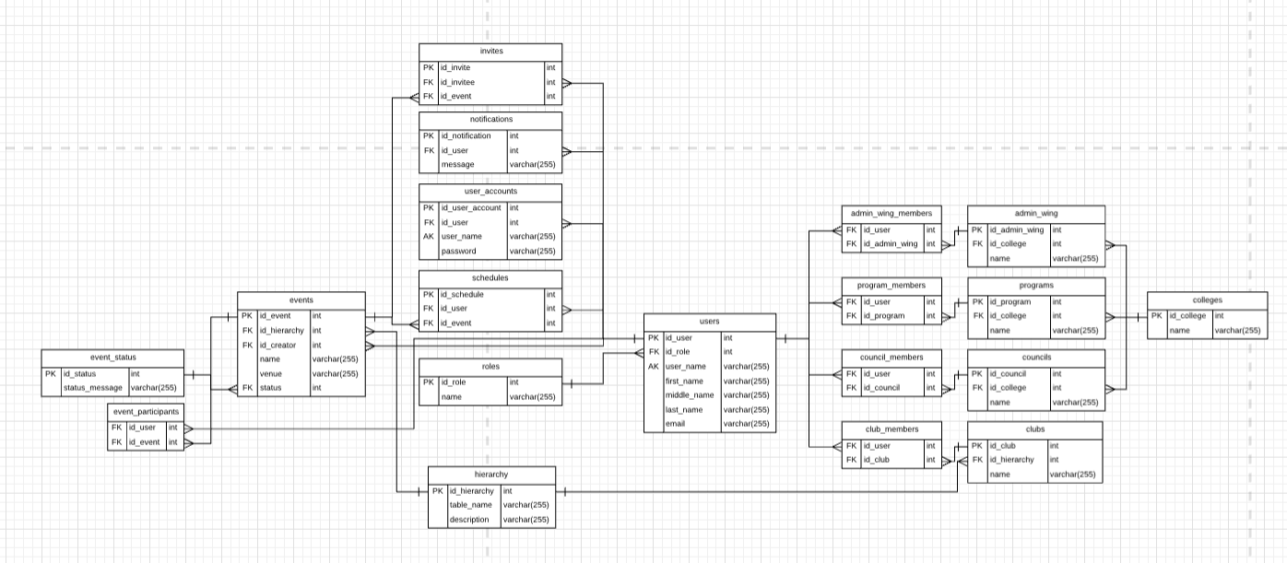
ER Diagram

Slide 8
ACTORS AND USECASES:
Application Master :
Creates and manages users at different levels
Approves or rejects open event requests
Views Event Statistics
Creates and manages Colleges, programs, administrative wing and councils
Creates events at various levels
Network Admin:
Creates and manages users at network level
Approves or rejects network event requests
Creates and manages various entities in their network
Creates events at network level

Slide 9
ACTORS AND USECASES(contd.)
Enterprise Admin :
Creates and manages Programs, Administrative wing and Councils
Creates and manages users at college level
Creates and manages events at college level
Approves or Rejects corresponding college level event requests and forwards other requests to the respective admins.
Organization Admin :
Creates and manages users at organization level.
Creates and manages events at organization level.
Approves or Rejects corresponding organization level event requests and forwards other requests to the respective admins.

Slide 10
ACTORS AND USECASES(contd.)
Event Manager :
Creates and manages events at different levels.
Doesn’t need to get approval to create an event.
Faculty:
Creates and manages events at different levels.
Needs to get approval to create an event.
Special Student :
Creates and manages events at different levels.
Can register and participate in different events.

Slide 11
ACTORS AND USECASES(contd.)
Student :
Can register and participate in different events
Guest:
Can register and participate in different events
Unlike Students, guests can only register for the events they are invited to

Slide 12
Ecosystem Hierarchy:
University (Ecosystem)
College (Network)
Enterprises (Program, Administrative Wing, Councils)
Organizations

Slide 13
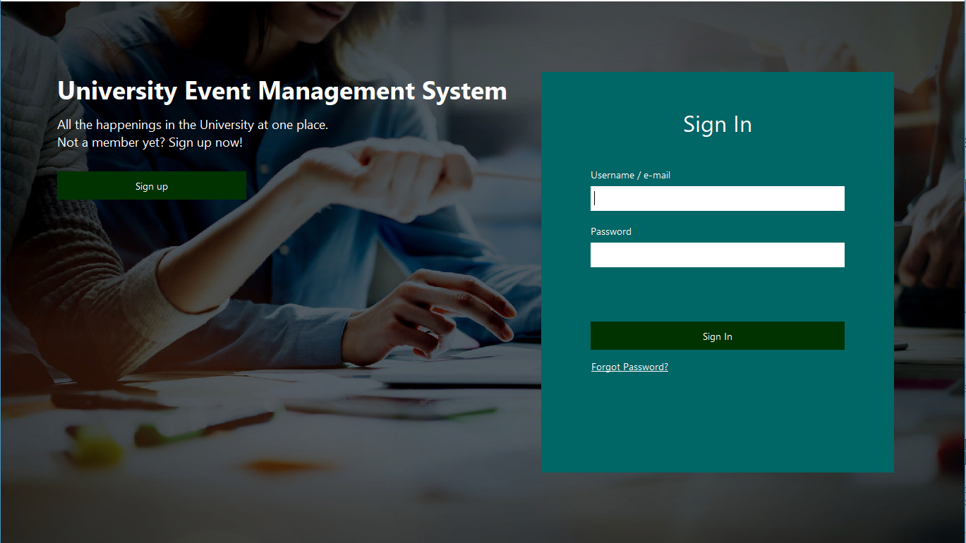
SCREENSHOTS:
Login Page

Slide 14
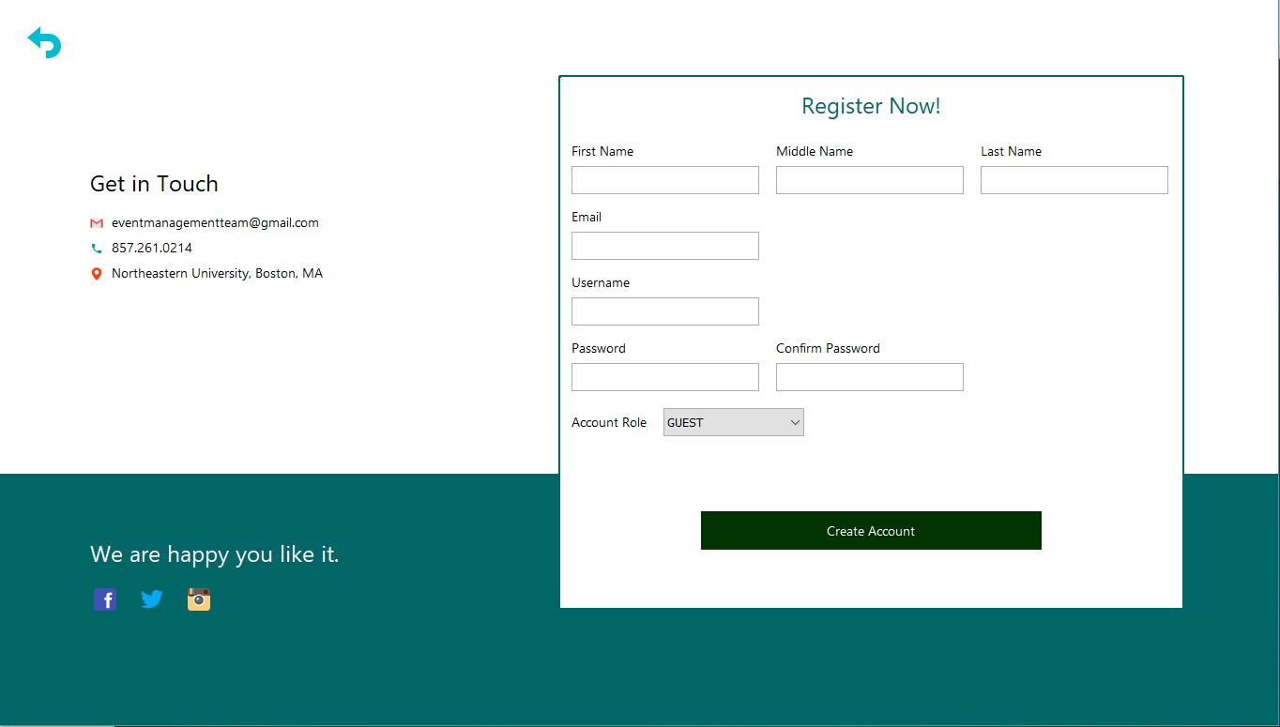
SCREENSHOTS:
Register Page

Slide 15
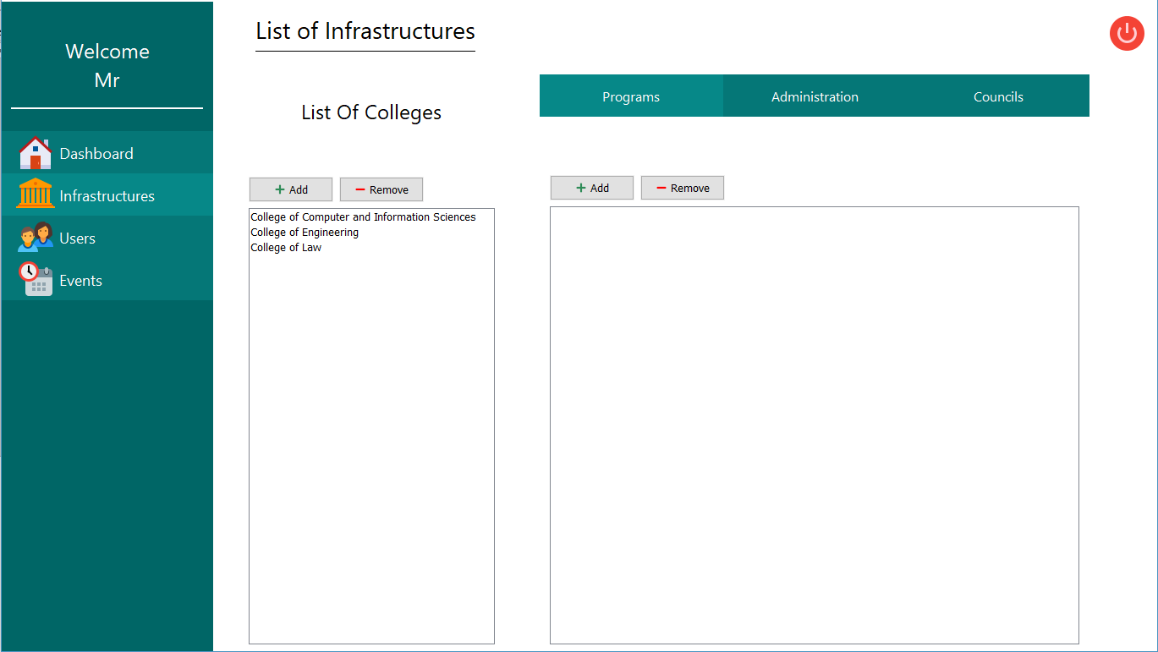
SCREENSHOTS:
Place where admin can add Enterprises and organization

Slide 16
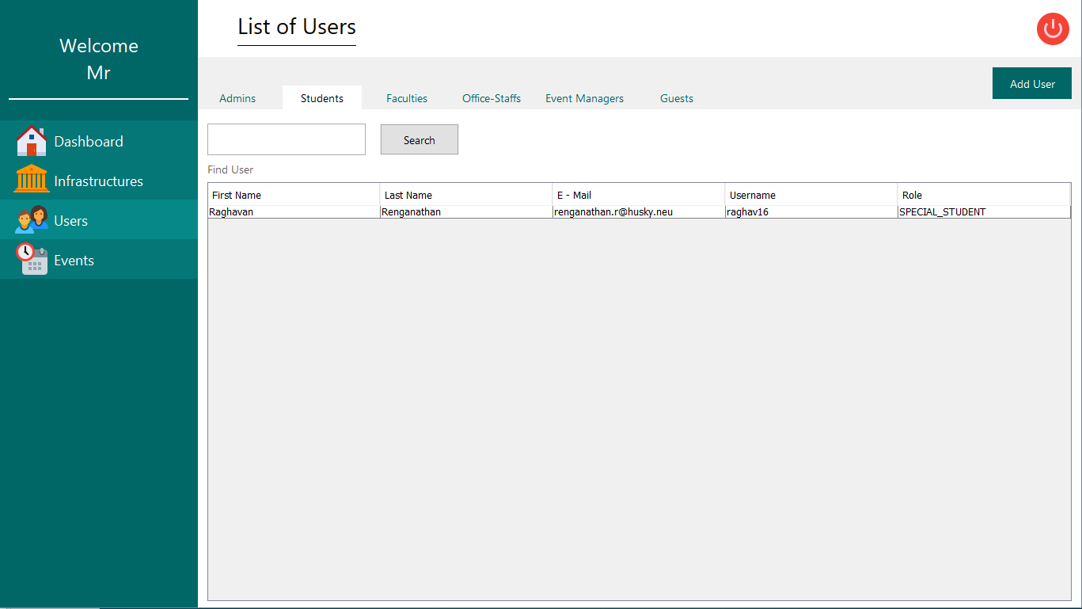
SCREENSHOTS:
Manage Users

Slide 17
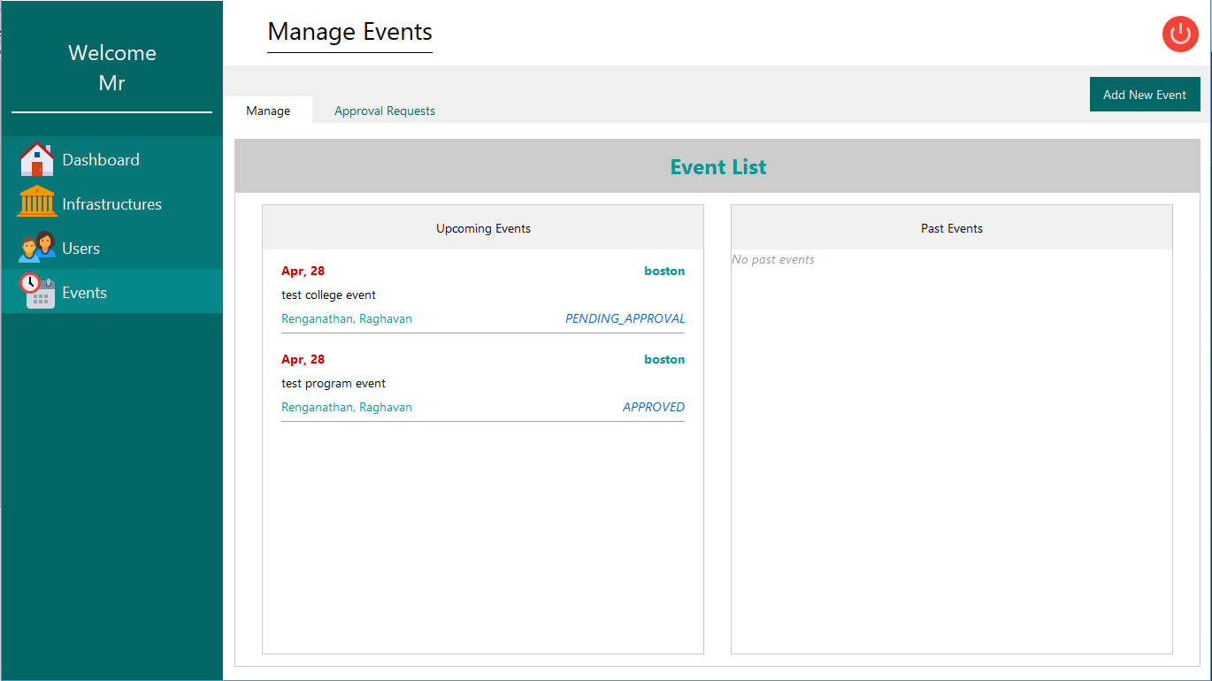
SCREENSHOTS:
Managing Events

Slide 18
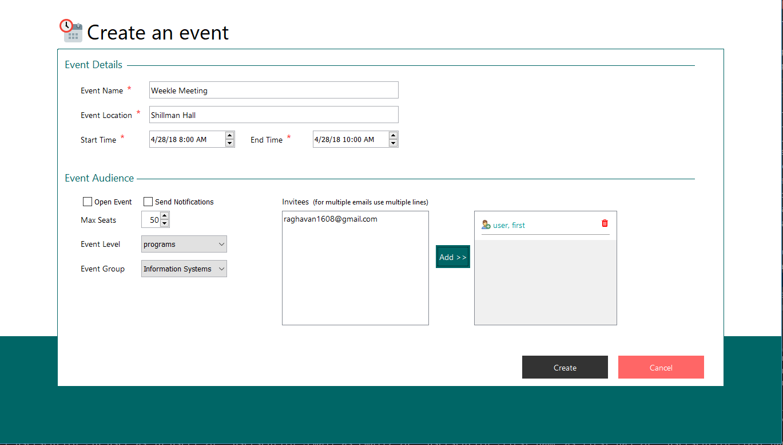
SCREENSHOTS:
Creating Events

Slide 19
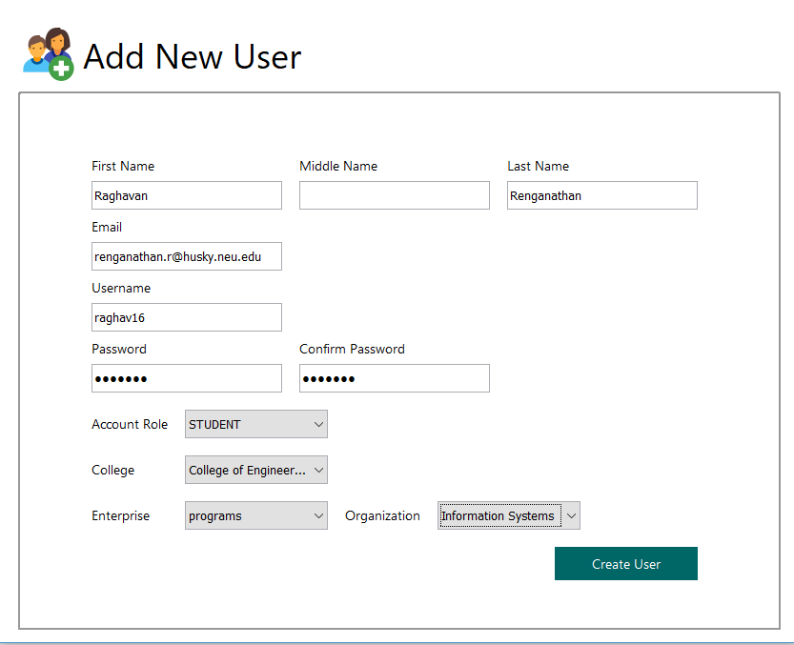
SCREENSHOTS:
Creating Users

Slide 20
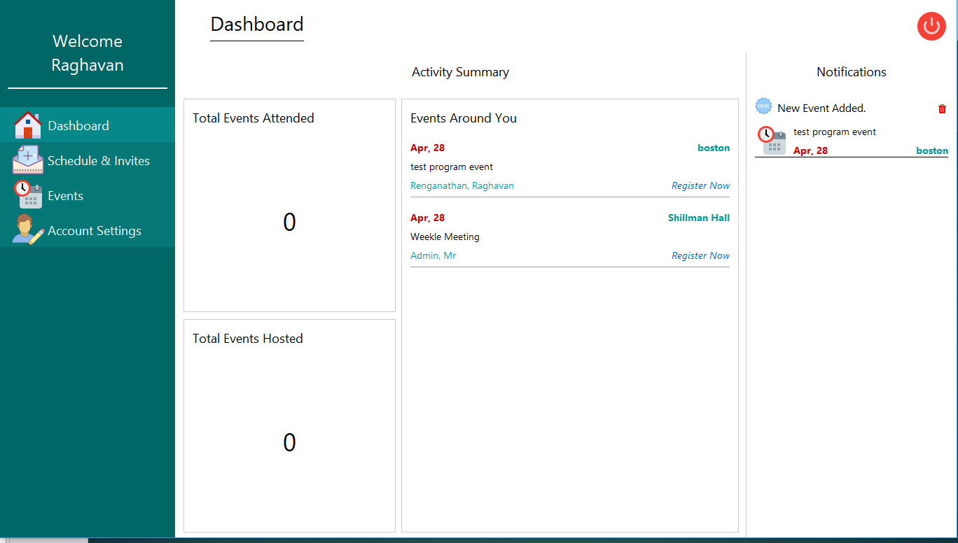
SCREENSHOTS:
Users Dashboard

Slide 21
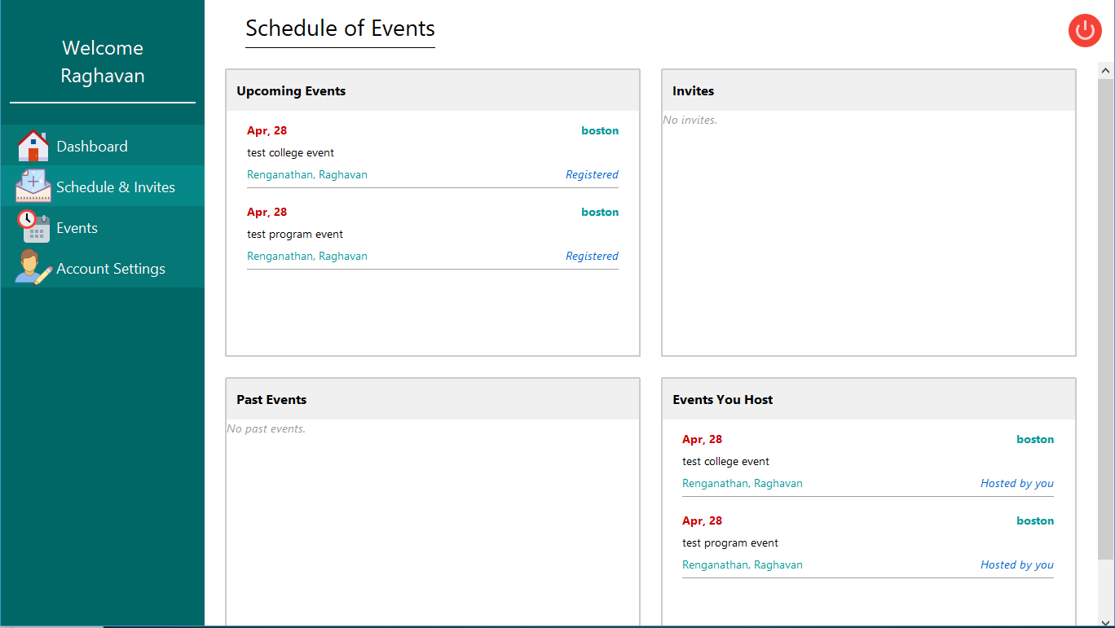
SCREENSHOTS:
Users Schedule

Slide 22
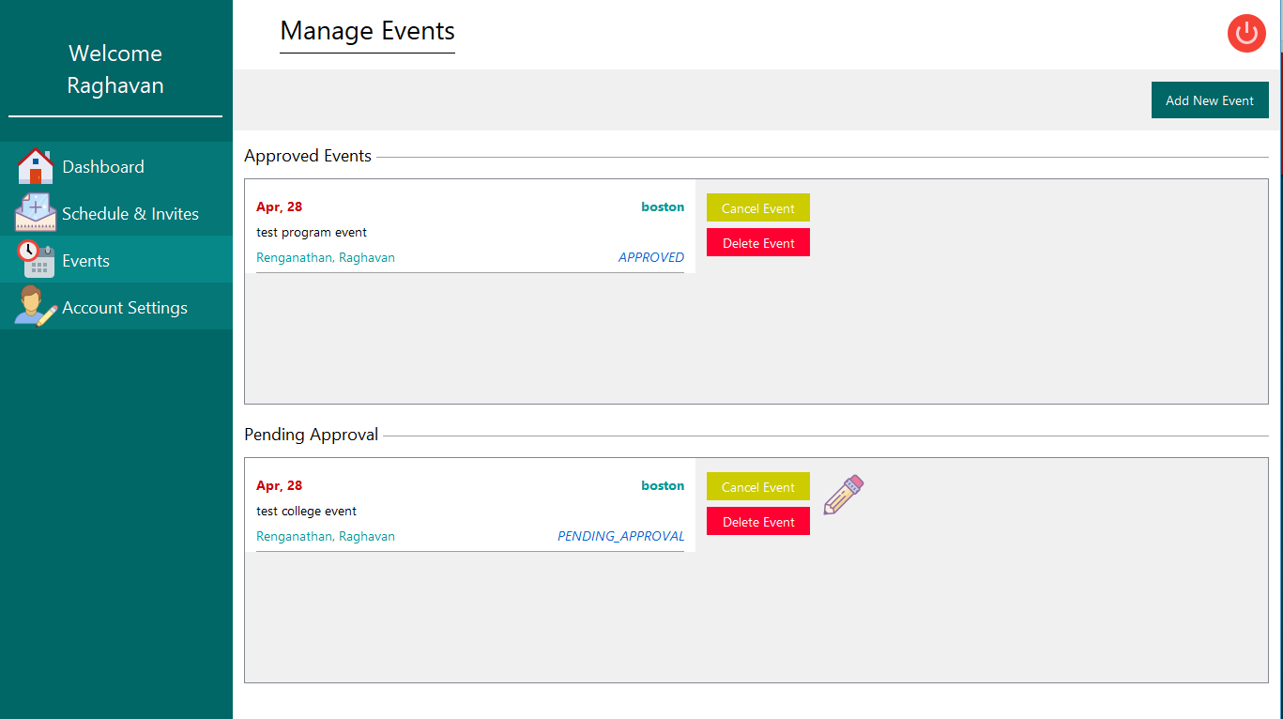
SCREENSHOTS:
Managing Events

Slide 23
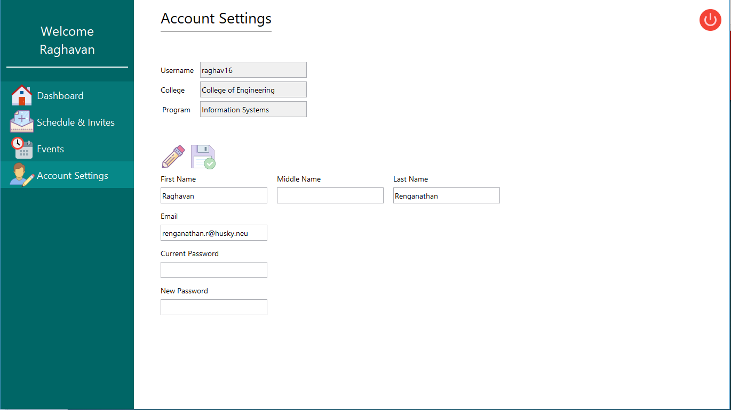
SCREENSHOTS:
Account Settings

Slide 24
Thank You!

